Slide 1
Introduction to HDL (Hardware Description Language)
By- chandramouli Haldar

Slide 2
What is HDL?
Hardware Description Language (HDL) is a programming language that is used to describe the structure, behavior and timing of electronic circuits, and most commonly, digital logic circuits.
HDLs are used for designing processors, motherboards, CPUs and various other Digital circuits. In addition to their use in circuit design, HDLs serve the purpose of simulating the circuit and verifying its response.
Unlike normal programming languages, HDL describes hardware behavior and structure, not software.
The most popular types of HDLs are VHDL and Verilog

Slide 3
Why HDL is Required in VLSI?
Before HDL:
Circuits were designed using schematics.
Very complex for large chips.
With HDL:
We can design millions of transistors using code.
Easy simulation before fabrication.
Reusable and scalable design.
Required for synthesis → Physical chip.

Slide 4
Purpose of HDLs:
Circuit Design: It provides a way to design digital circuits that meet the required specifications.
Simulation: It helps the designer to test and verify the digital circuit before it is built.
Verification: It provides designers to verify the functionality of the Digital circuit by testing it against different inputs and ensuring that the circuit functionality is correct and meets the desired functionality.
Synthesis: HDLs can be used to synthesize digital circuits. Synthesis is a process of automatically generating circuits from HDL code.

Slide 5
Purpose of HDLs:
Timing Analysis: It provides designers to analyse the timing behaviour of digital circuits and ensure that the circuits meet the timing requirements.
Design Reusability: HDLs provide a way to design reusable components that can be used for multiple circuits design and reduce time and effort, which improves overall design quality.
Optimization: It Provides a way to optimise the design of digital circuits for performance.

Slide 6
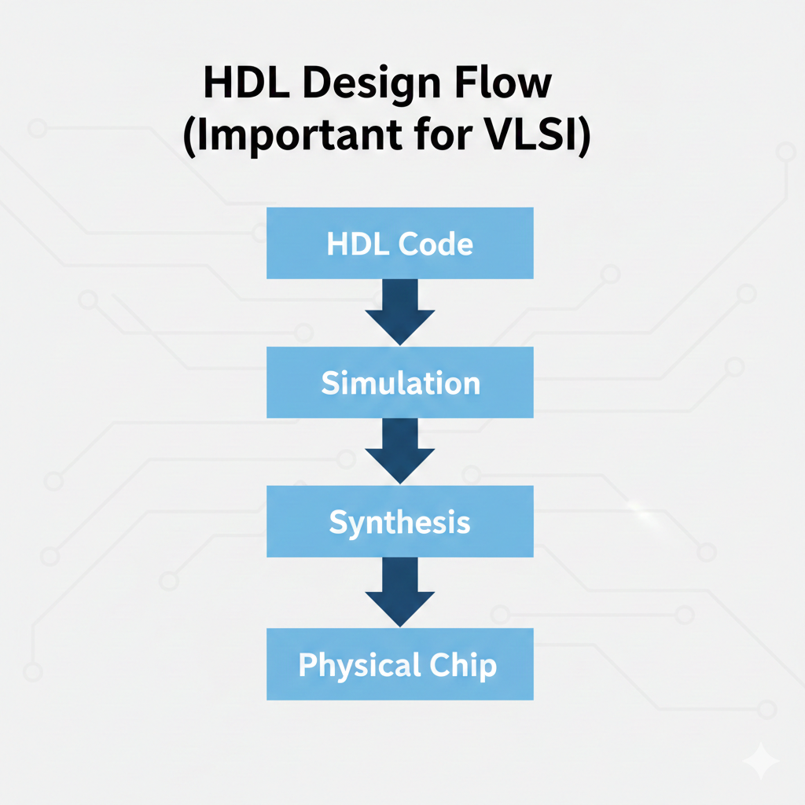

Slide 7
Advantages of HDL
Faster design
Easy modification
Simulation before fabrication
Reusable IP cores
Large scale integration possible
Requires strong digital knowledge
Simulation time increases for large circuits
Complex debugging

Slide 8


Slide 9
VHDL (Very High-Speed Integrated Circuit HDL)
Developed by:
US Department of Defense (1980s)
Full Form:
Very High-Speed Integrated Circuit Hardware Description Language
Features:
Strongly typed language
Verbose (long syntax)
Case insensitive
Good for large and complex systems
Popular in Europe & defense industries

Slide 10
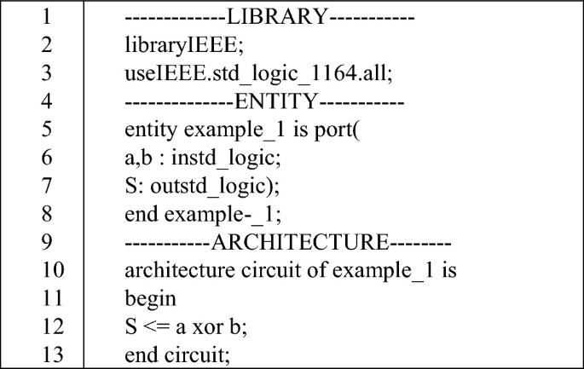
Basic Structure of VHDL
VHDL has two main parts:
Entity → Defines inputs & outputs
Architecture → Defines internal working

Slide 11
Verilog
Developed by:
Philip Moorby (1984)
Full Form:
Verilog stands for VERIfication and LOGic
Features:
C-like syntax
Easy to learn
Case sensitive
Compact syntax
Popular in USA & industry

Slide 12
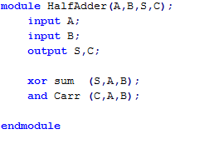
Basic Structure of Verilog
Verilog uses:
module → Defines hardware block
endmodule → End of block

Slide 13
Levels of Modeling in HDL
HDL supports 3 levels of modelling:
1. Behavioral Modeling
Describes how circuit behaves
Uses if-else, case
Example: Counter
2. Dataflow Modeling
Uses continuous assignments
Uses assign statement
Example: Logic equations
3. Structural Modeling
Connects gates/modules
Like schematic in code form
Instantiating modules

Slide 14
VHDL vs Verilog
Feature | VHDL | Verilog
Syntax | Verbose | Simple
Type System | Strongly typed | Weakly typed
Case Sensitive | No | Yes
Difficulty | Harder | Easier
Industry Use | Europe | USA & global
Style | Ada-like | C-like

Slide 15
What is SystemVerilog?
Advanced version of Verilog.
Features:
Object Oriented concepts
Better verification
Used in UVM
Supports Assertions
Used mostly in:
Design Verification
Testbench creation

Slide 16


www.edaplayground.com

Slide 17


https://dldv-iiith.vlabs.ac.in/List%20of%20experiments.html

Slide 18
THANK YOU!
The class will end at 1:30, not before that.

